Slide 1
update
Evolutionary Algorithm Generator for Controlling Strategies of a Batbot
安武
2023/10/24

Slide 2
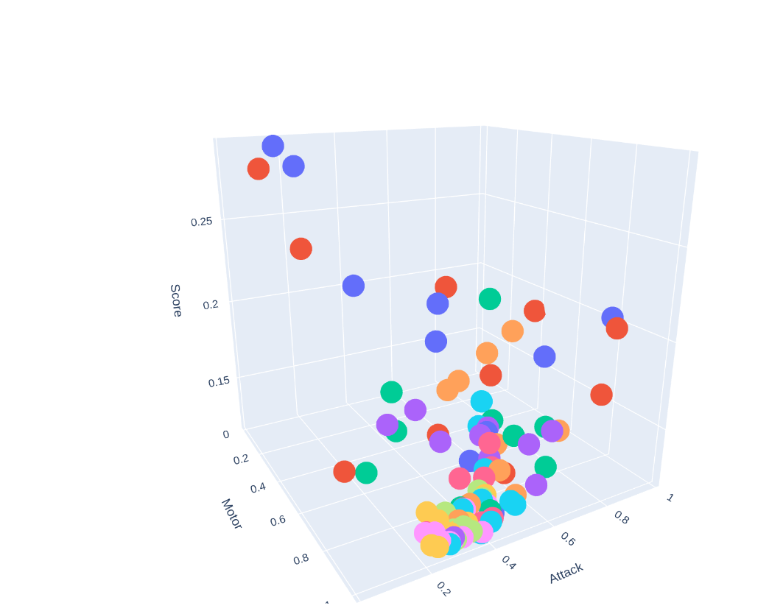
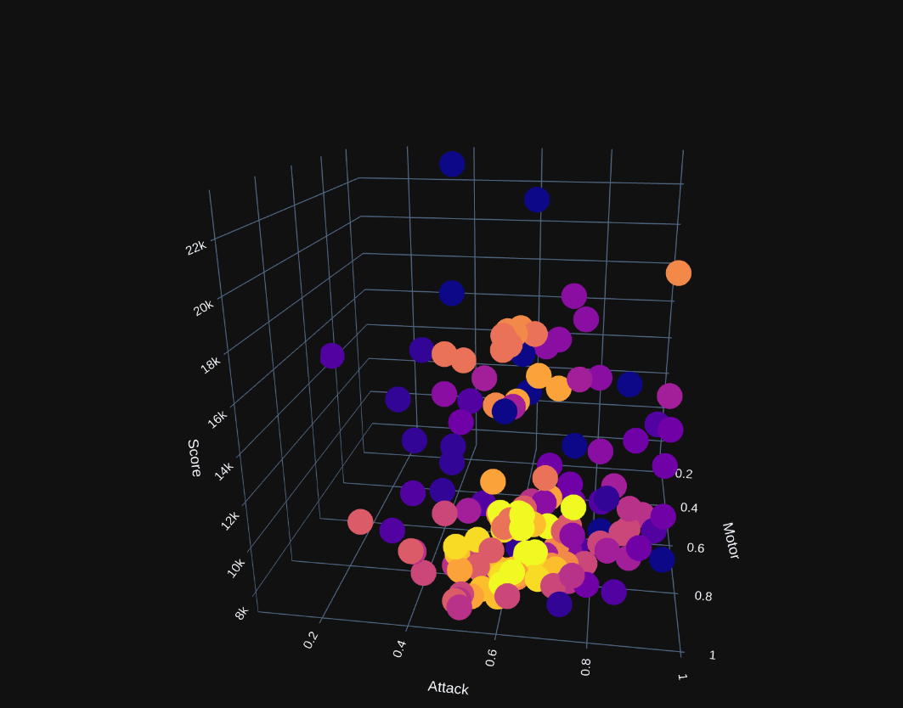
Optimization 2d (fREQUENCY AND ATTACK ANGLE)
I was able to find the perfect attack angle and motor speed
Help test the algorithm and the stability of new fitness scores as they were much constant

Slide 3
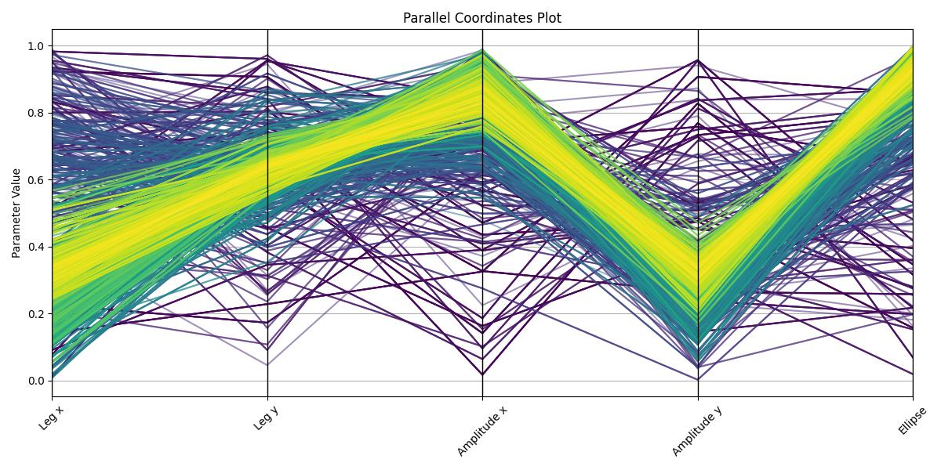
Optimization 5D
Fixed Batbot in the optimal attack angle and flapping frequency
Optimized 5D:
X leg angle
Y leg angle
X leg amplitude
Y leg amplitude
Ellipse shape

Slide 4
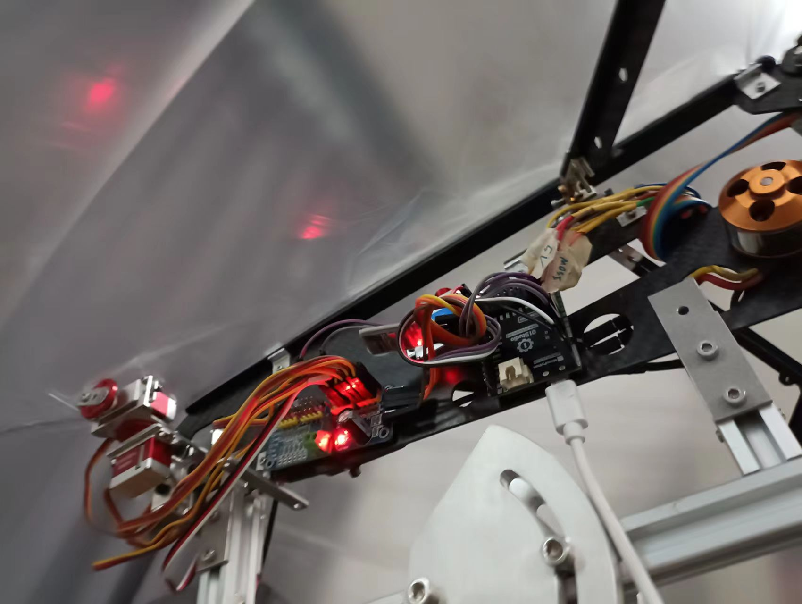
Rewiring for experiments
Went away from the prototype and rewired everything for experiments outside.
Lighter
More Robust

Slide 5
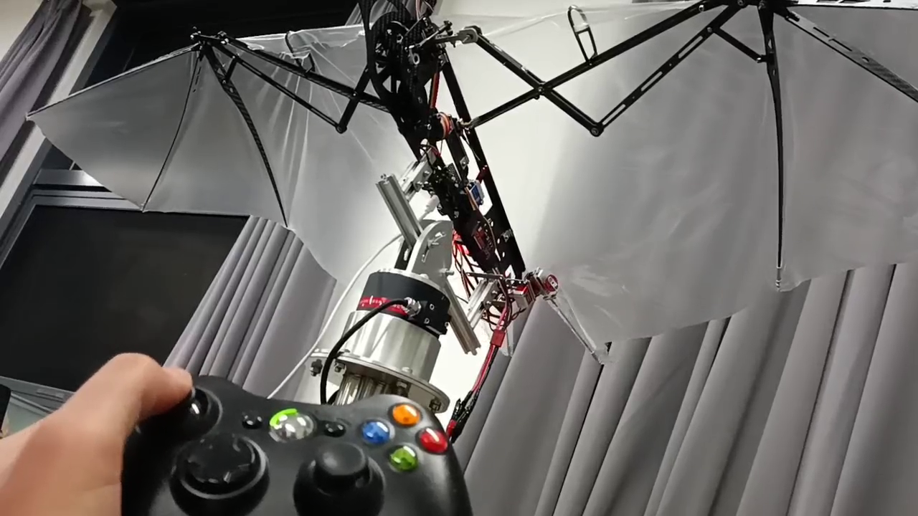
Wireless manual controlling
In order to experiment I built a system to control the Batbot using a manual controller

Slide 6
Results
Able to proof that the genetic algorithm works and gives relevant data
First experiments on real Batbot
Problem:
Sensors was not accurate enough to improve further
Sensor configuration would not allow to measure real hovering
Solution:
Buy better sensor

Slide 7
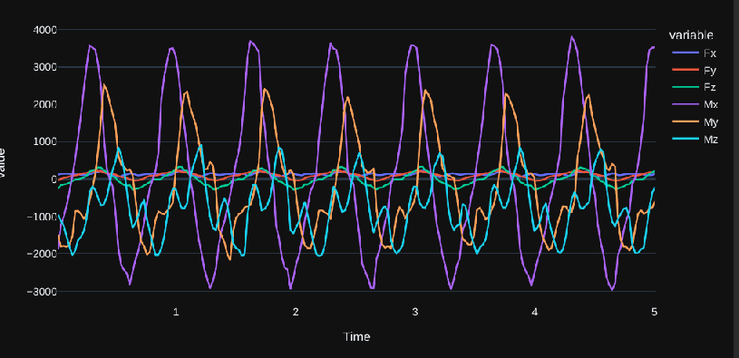
Better sensor installation
Took around 10 days to connect to python, as connection is complex.
Good quality of sensor that gives force and torque

Slide 8
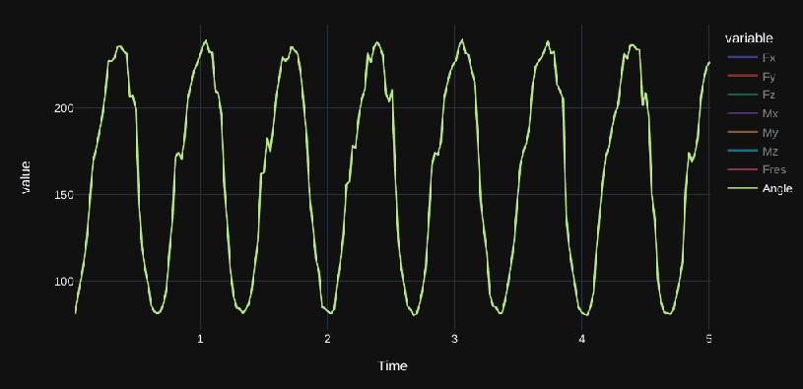
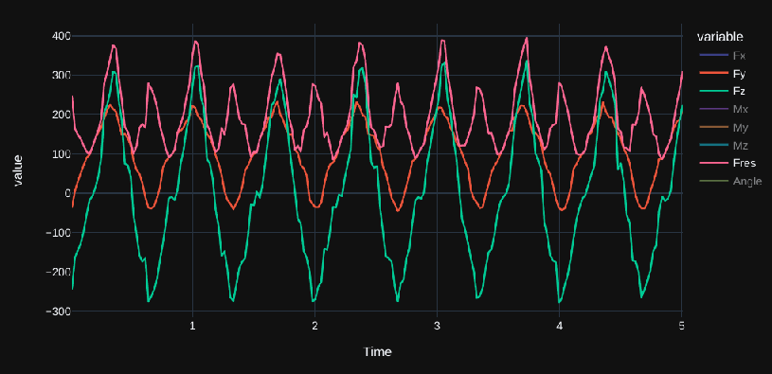
resulting force and angle
Using Fy and Fz we can calculate the resulting force and its angle

Slide 9

resulting force and angle

Slide 10
Coming steps
Use angle information to reposition Batbot and repeat 5D optimization using the better new force sensor → feedforward controller
Build and use dynamic test bench to train hovering in dynamic situation (even with perturbation) → feedback controller
Idea for simple and effective dynamic testbench. Use 6 axis sensor and hang the Batbot from elastic (with the Fres direction and magnitude we can calculate the position of the Batbot)

Slide 11
Thank you!

